Slide 1
INTELLIHIRE - AI –BASED JOB SCAM DETECTION SYSTEM

Slide 2
ABSTRACT
Online job portals and social media platforms have become dominant channels for recruitment. However, the rapid expansion of these platforms has also resulted in a sharp increase in fake job postings and fraudulent recruiters, leading to financial loss, identity theft, and psychological distress among job seekers. Conventional scam detection techniques such as manual moderation and rule-based keyword filtering are ineffective against evolving and sophisticated scam strategies.
This project proposes a Deep Learning–based Job Scam Detection System that automatically identifies fake job posts and fraudulent recruiters using advanced neural networks and Natural Language Processing (NLP).

Slide 3
The system analyzes job descriptions, recruiter profiles, communication behavior, and metadata using deep learning model such as MLP.
By learning complex linguistic patterns and behavioral anomalies - such as unrealistic salary offers, urgency-driven language, suspicious contact information, and abnormal recruiter activity—the system accurately classifies job postings as genuine or fraudulent. A risk scoring mechanism further enhances decision-making by prioritizing high-risk content. The proposed system significantly improves trust, safety, and transparency in online recruitment platforms while minimizing false positives.

Slide 4
EXISTING SYSTEM
Most existing job portals rely on manual verification, rule-based filters, or user reporting mechanisms to detect fake job postings and recruiters. These approaches are static and incapable of handling modern scam tactics that constantly evolve.
Disadvantages of Existing System
  • Manual verification is time-consuming and inconsistent
  • Rule-based filters fail against adaptive scam techniques
  • Keyword-based detection produces high false positives
  • Delayed response to fraudulent postings
  • Over-reliance on user complaints
  • Poor scalability for large-scale platforms

Slide 5
PROPOSED SYSTEM
The proposed system leverages Deep Learning, NLP, and behavioral analytics to automatically detect fraudulent job posts and recruiters in real time. Unlike traditional methods, deep learning models learn hidden and contextual patterns directly from data without relying on predefined rules.
The system evaluates job content semantics, recruiter credibility, historical behavior, and communication patterns to generate a fraud probability score. Transformer-based language models understand contextual meaning, intent, and deceptive phrasing commonly used in job scams. The system continuously improves by learning from new scam data and supports explainability for transparent decision-making.

Slide 6
Advantages of Proposed System:
• Fully automated real-time scam detection
• High accuracy using deep neural networks
• Detects unseen and evolving scam patterns
• Reduces false positives significantly
• Enhances platform trust and security
• Scalable for enterprise-level recruitment platforms

Slide 7
MODULES
1. Data Collection Module
  This module collects large-scale datasets from job portals, social media platforms, and historical scam repositories. The collected data includes job titles, descriptions, salary information, recruiter profiles, email IDs, phone numbers, URLs, timestamps, and user feedback.
2. Data Preprocessing Module
Raw data is prepared for deep learning models through:
• Noise removal and duplicate elimination
• Tokenization ,sequence padding and Text normalization(lowercasing, stop-word removal)
• Handling missing and inconsistent data

Slide 8
3. Feature Representation Module
  Instead of manual feature engineering, this module uses deep learning embeddings:
  • Word embeddings (Word2Vec, GloVe)
  • Contextual embeddings (BERT, RoBERTa)
  • Behavioral embeddings from recruiter activity
  • Metadata embeddings for domains and contact details
4. Deep Learning–Based Detection Module
This core module uses neural network architectures to classify job posts and recruiters:
MLP:

Slide 9
5. Fake Recruiter Identification Module
This module analyzes recruiter activity across multiple postings using deep learning–based anomaly detection to identify coordinated or repeated scam behavior.
6. Risk Scoring & Alert Module
Each job post and recruiter is assigned a deep learning–generated risk score. High-risk content is automatically flagged, blocked, or forwarded for administrative review. Real-time alerts are generated for platform administrators.

Slide 10
7. Admin Dashboard Module
Provides administrators with:
• Real-time monitoring of flagged job posts
• Recruiter risk analysis
• Scam trend visualization
• Manual override and verification controls
8. User Notification Module
Job seekers receive warnings for suspicious job posts along with safety recommendations before proceeding with applications.

Slide 11
HARDWARE SPECIFICATION
Processor Speed : 1.0 GHz or higher
Processor Type : 64-bit CPU (recommended)
  32-bit also supported for older Python versions
RAM : Minimum 2 GB (4 GB recommended)
Disk Space : At least 500 MB free

Slide 12
SOFTWARE SPECIFICATION
Front-end : HTML / CSS, JavaScript
Back End : PYTHON
Framework : FLASK
Database : SQLite
Operating System : Windows 10+, Linux, macOS

Slide 13
FUTURE ENHANCEMENT
The IntelliHire AI-based job scam detection system can be significantly enhanced by integrating advanced transformer models such as GPT-style architectures and domain-specific BERT to improve contextual understanding and detection accuracy. The addition of blockchain-based recruiter identity verification will provide a secure and tamper-proof mechanism to ensure the authenticity of job providers.
Furthermore, incorporating explainable deep learning (XAI) techniques will make the system’s decision-making process transparent, helping users understand why certain job postings are flagged as suspicious and increasing overall trust in the platform.

Slide 14
In addition, enabling cross-platform scam intelligence sharing will allow the system to gather and analyze threat data from multiple sources, strengthening its ability to identify emerging scam patterns. Seamless mobile and browser extension integration will ensure users have access to protection across different devices and platforms. Real-time push notifications and alerts will further enhance user safety by providing immediate warnings about potential job scams, allowing users to take quick and informed actions to avoid fraudulent opportunities.

Slide 15
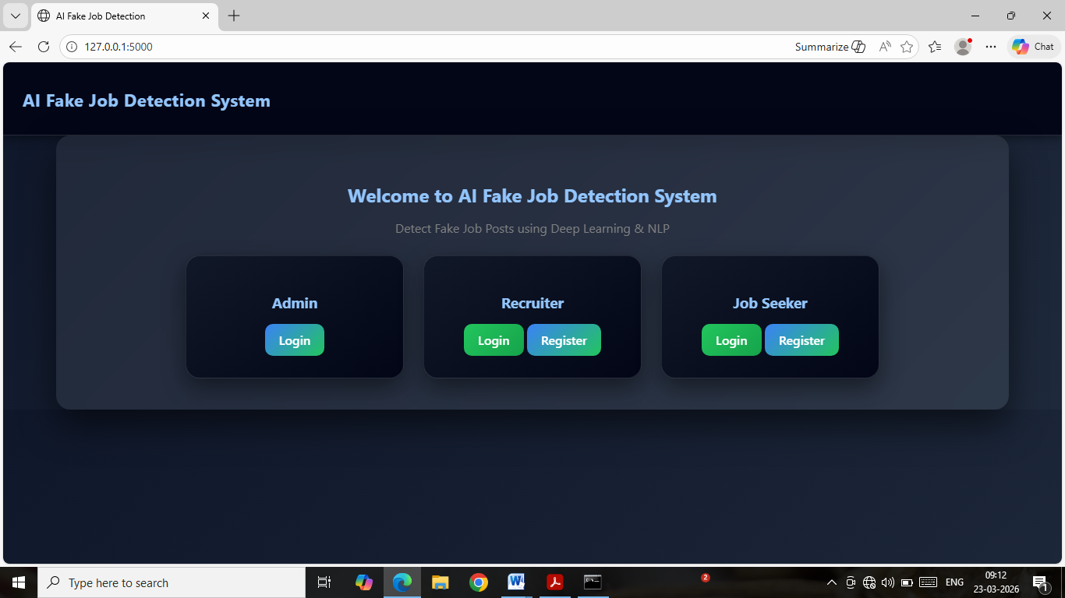
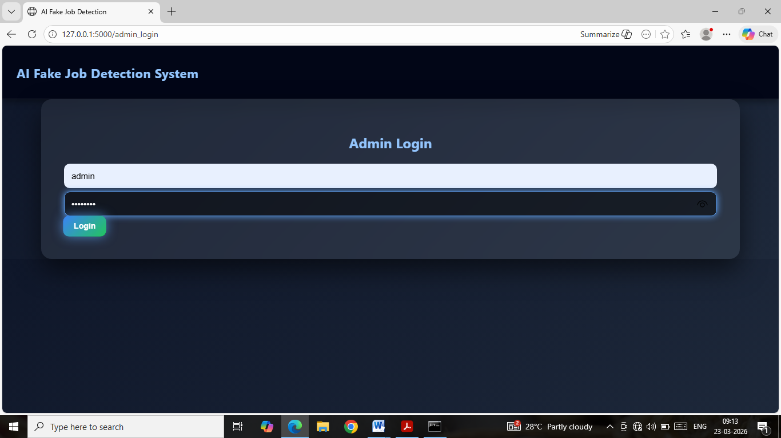
HOME PAGE
ADMIN LOGIN

Slide 16
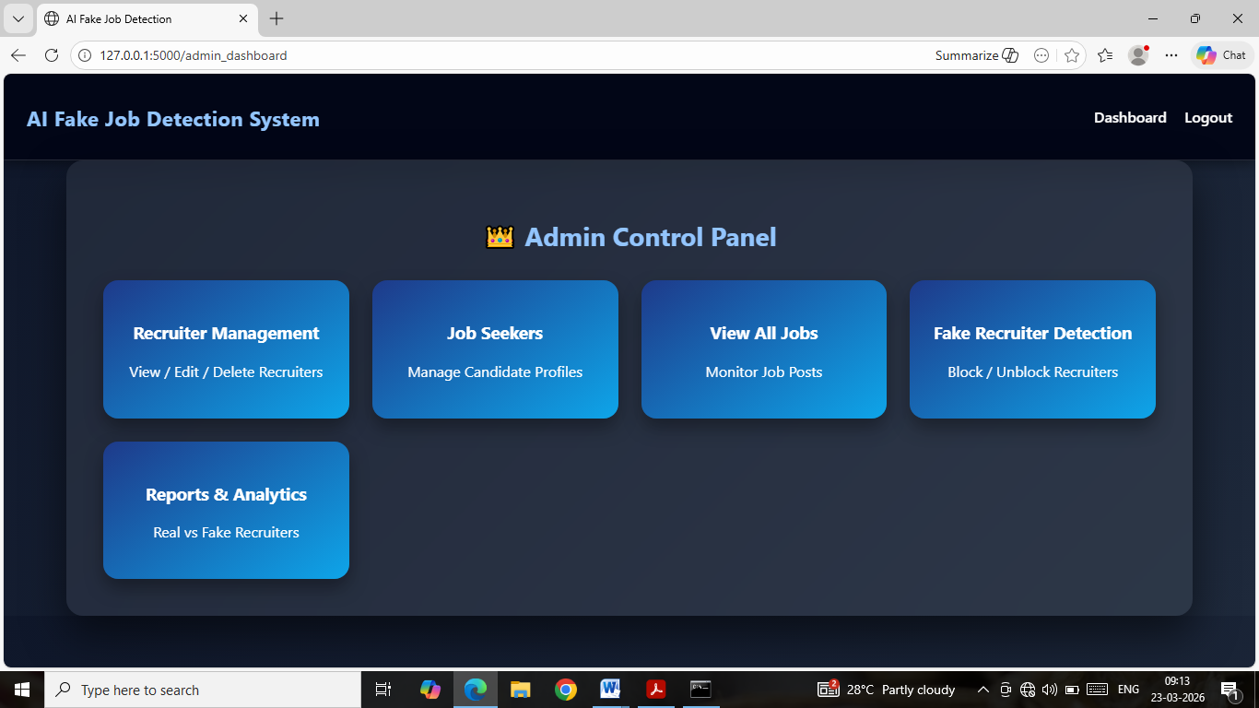
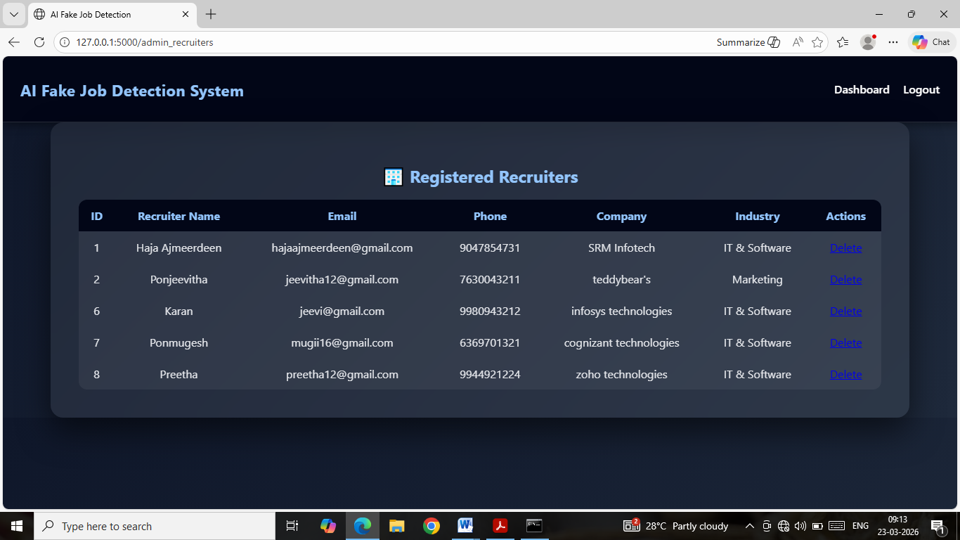
ADMIN DASHBOARD
RECRUITER MANAGEMENT

Slide 17
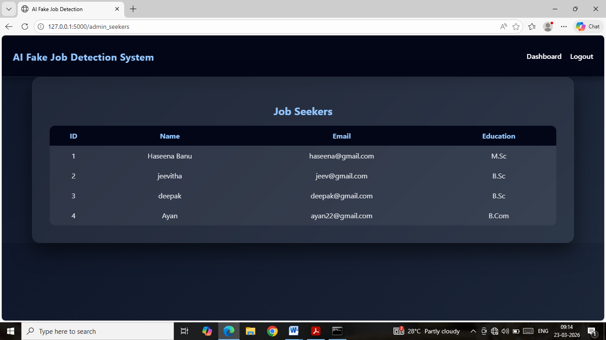
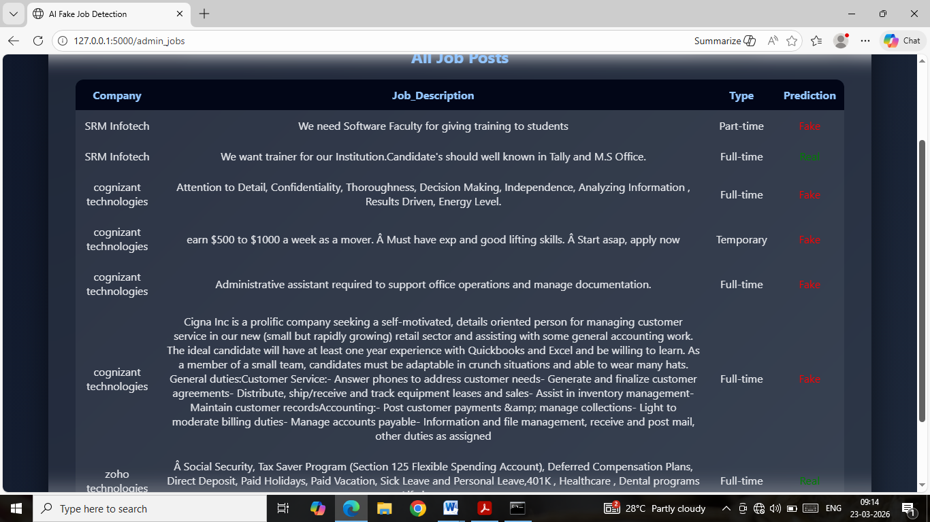
JOB SEEKERS MANAGEMENT
JOB POST PREDICTION

Slide 18
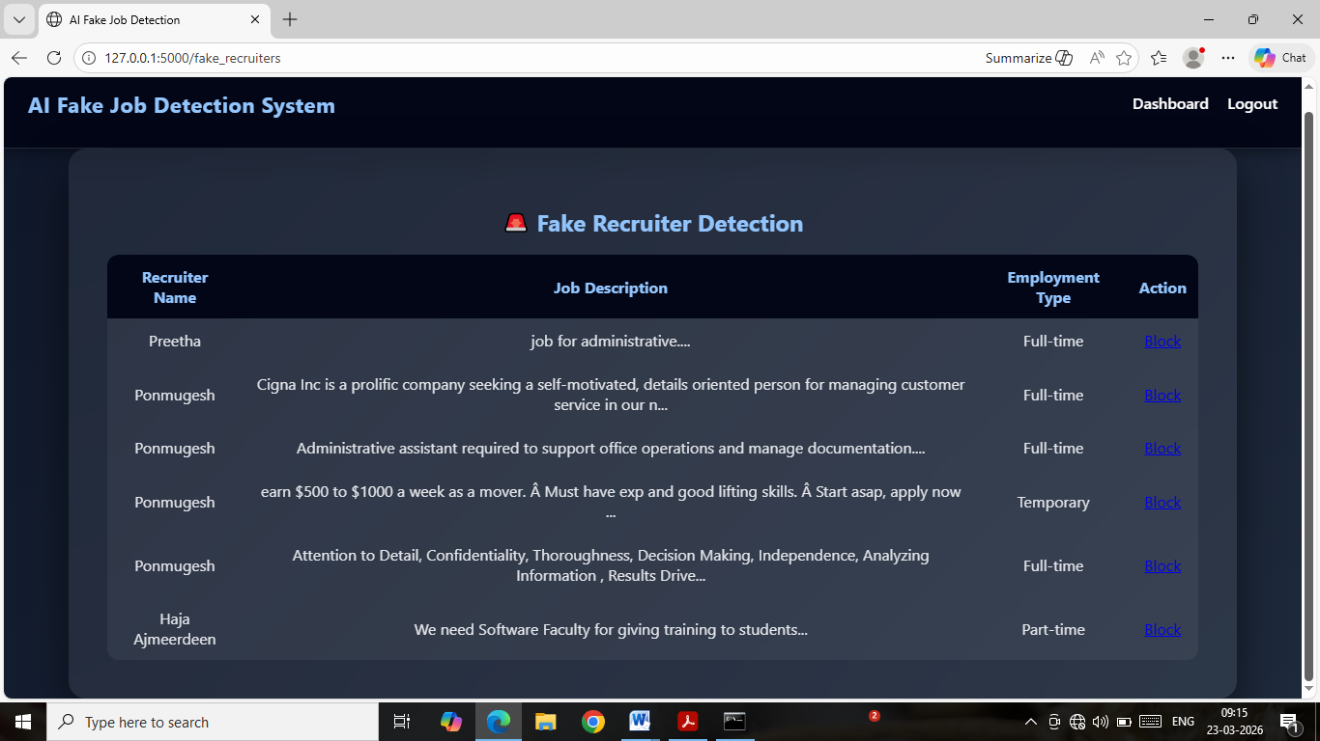
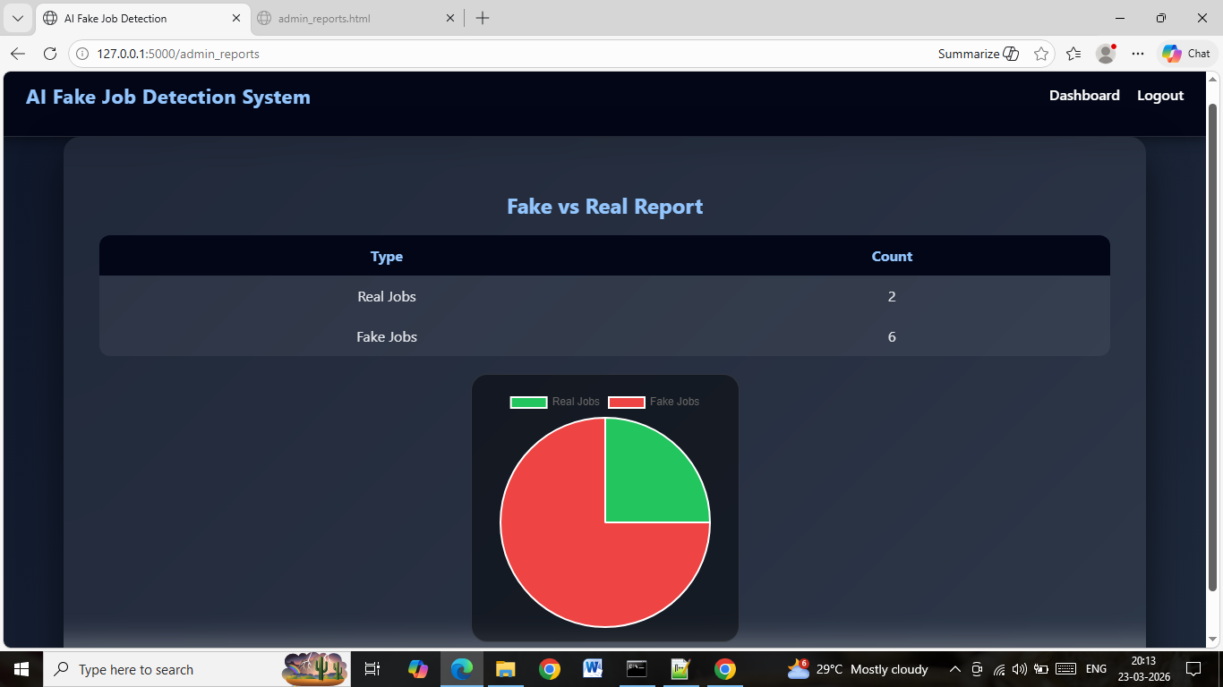
FAKE RECRUITER DETECTION
REPORT ANALYSIS

Slide 19
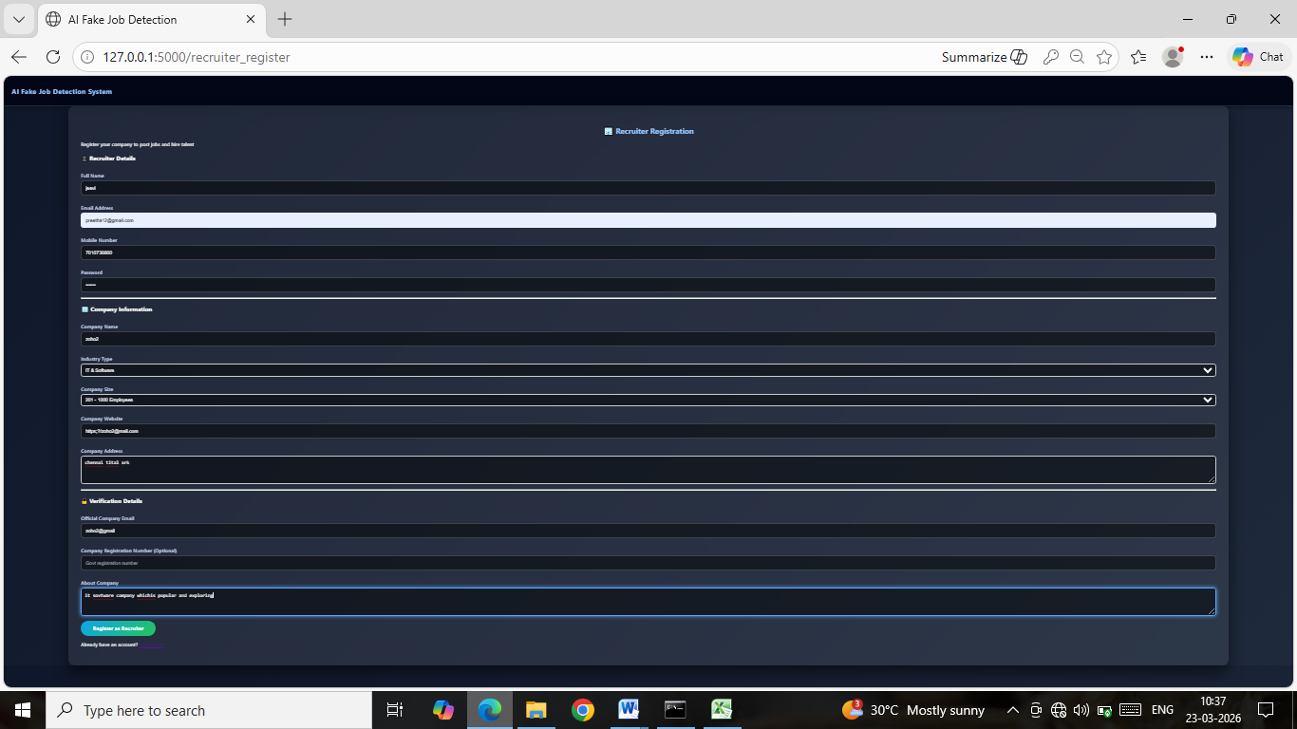
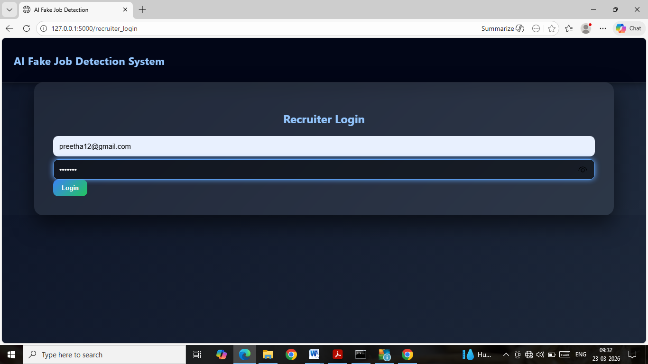
RECRUITER REGISTRATION
RECRUITER LOGIN

Slide 20
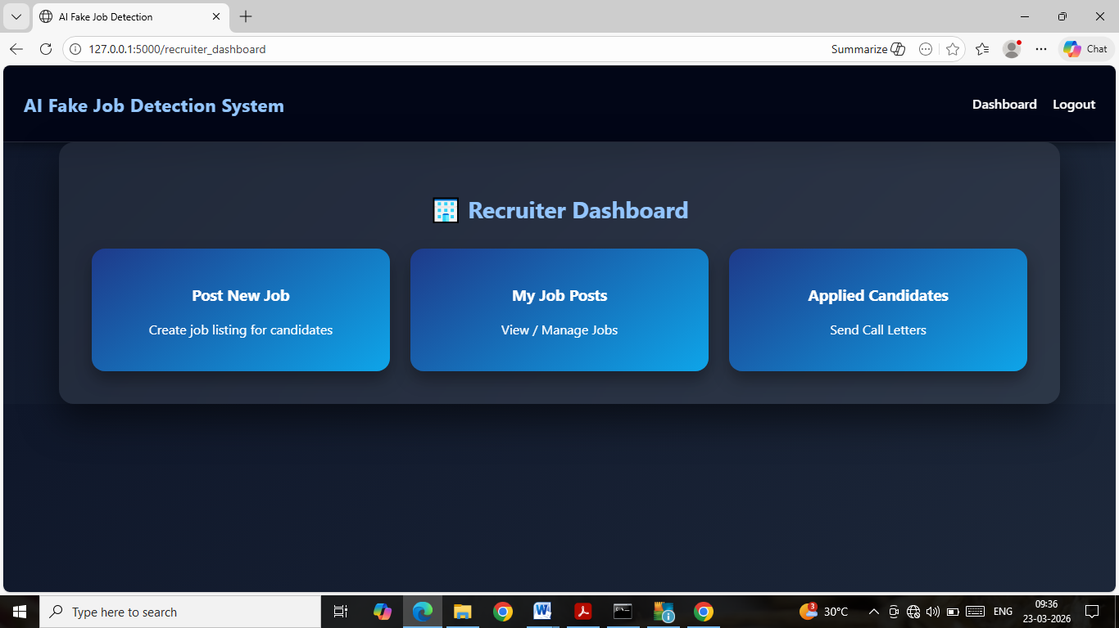
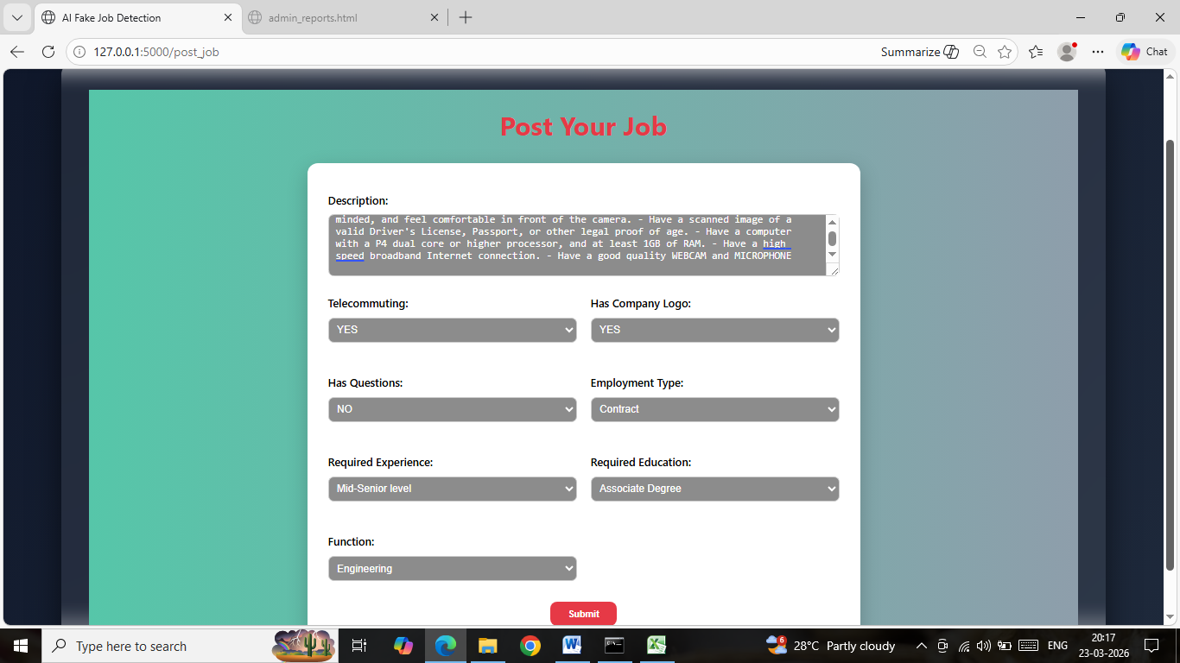
RECRUITER DASHBOARD
POST YOUR JOB

Slide 21
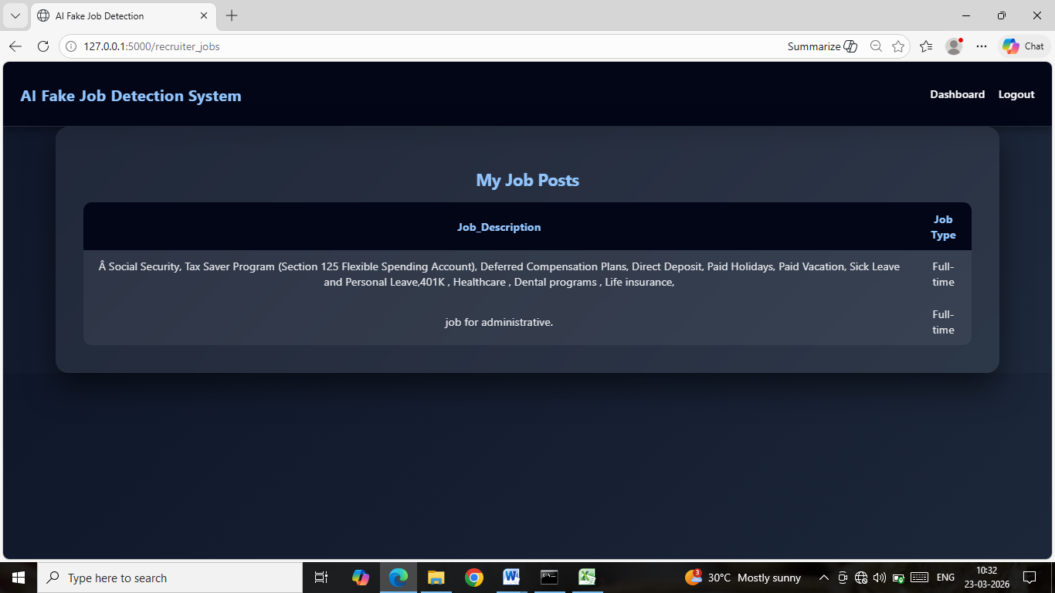
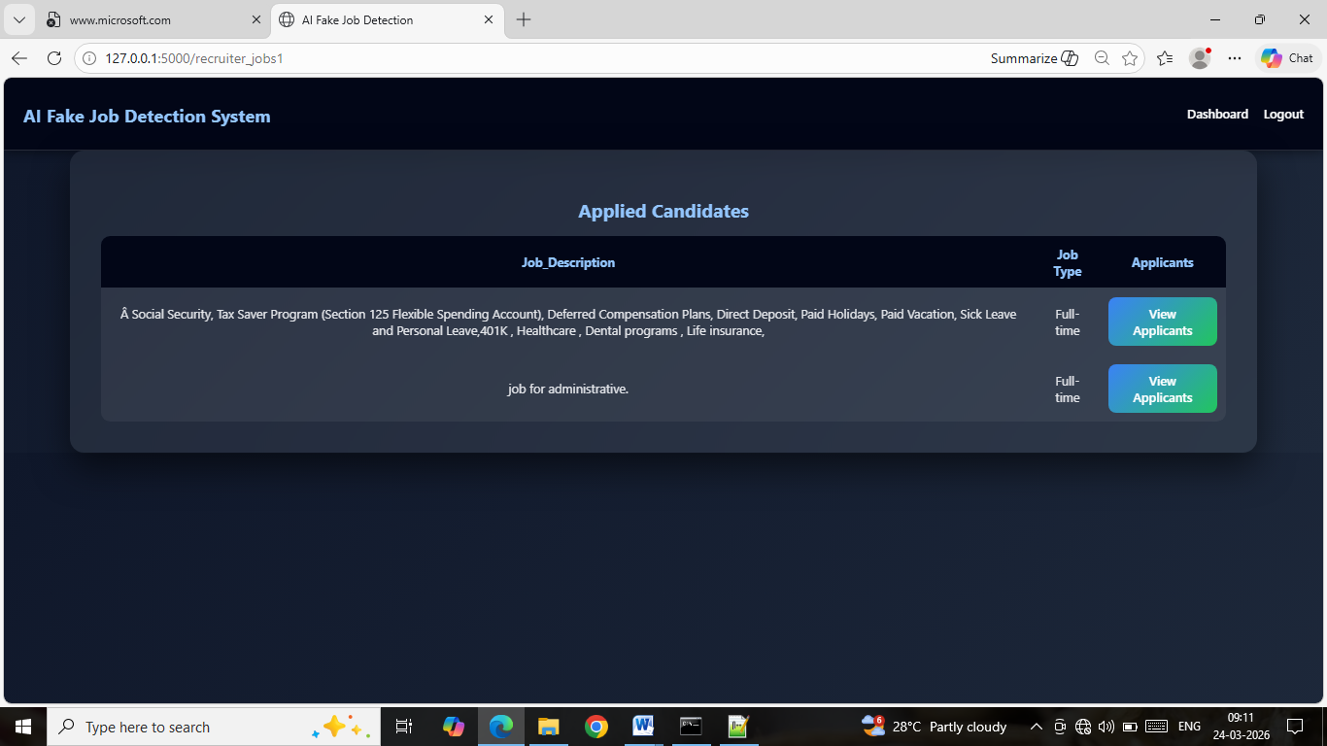
JOB POSTS
APPLIED CANDIDATES

Slide 22
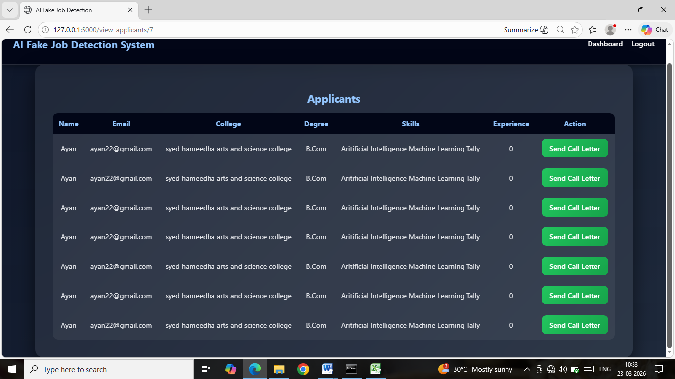
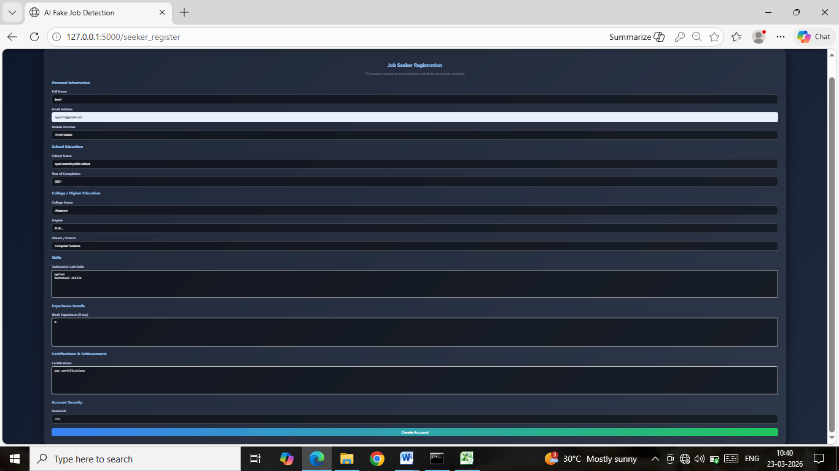
APPLICANTS
SEEKER REGISTRATION

Slide 23
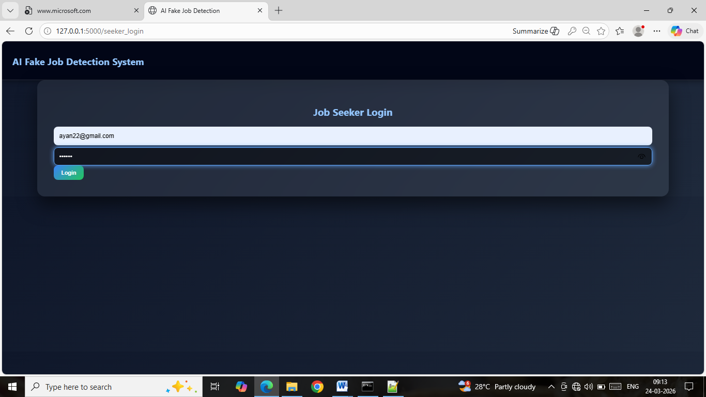
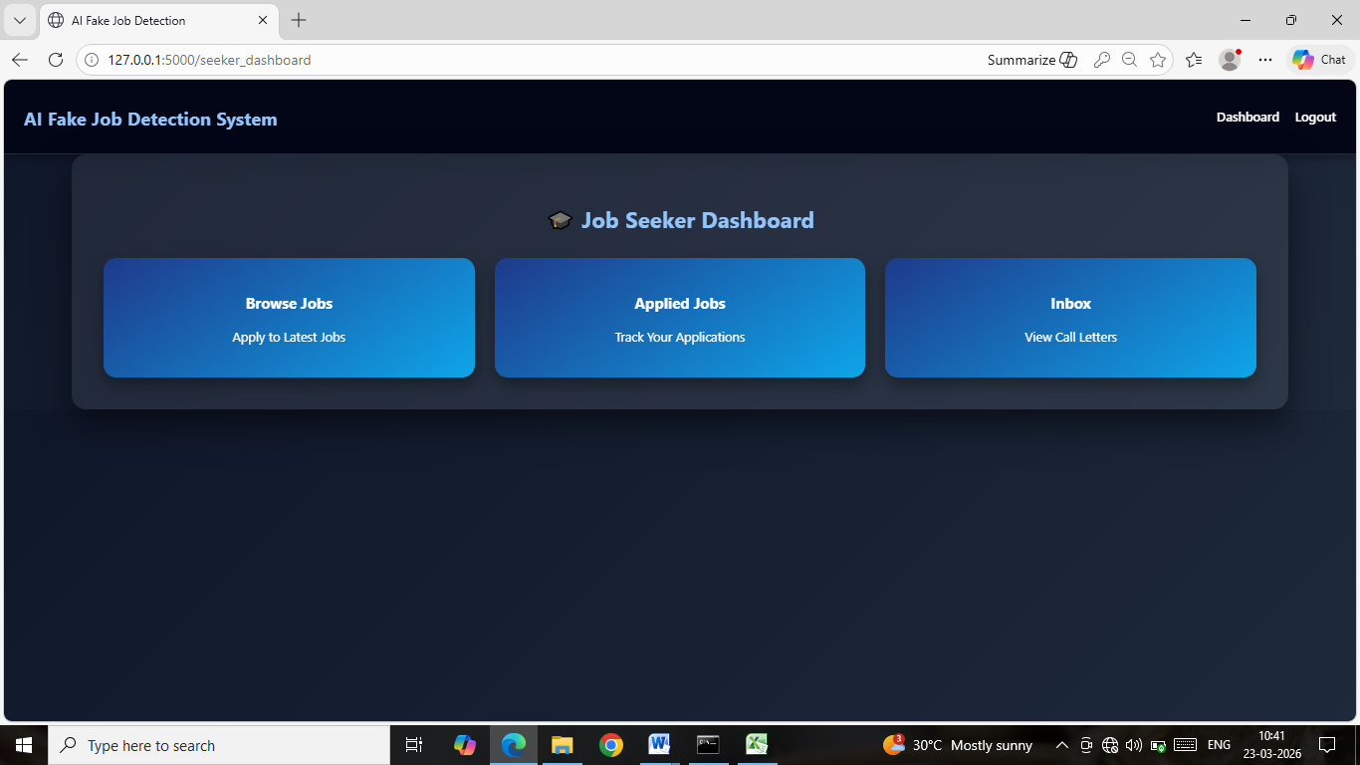
SEEKER LOGIN
SEEKER DASHBOARD

Slide 24
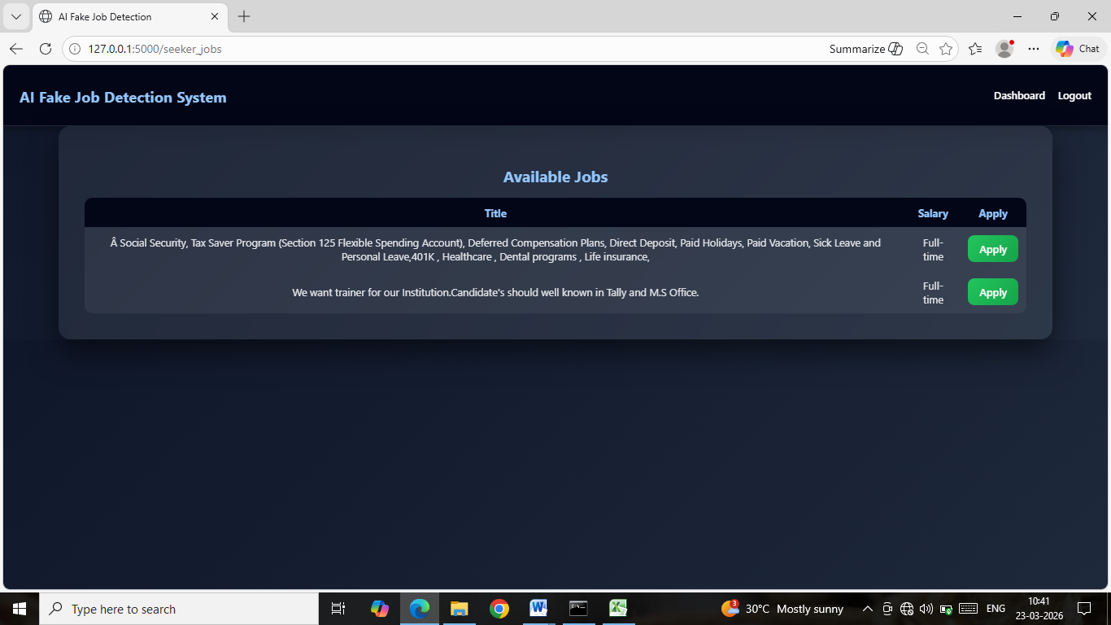
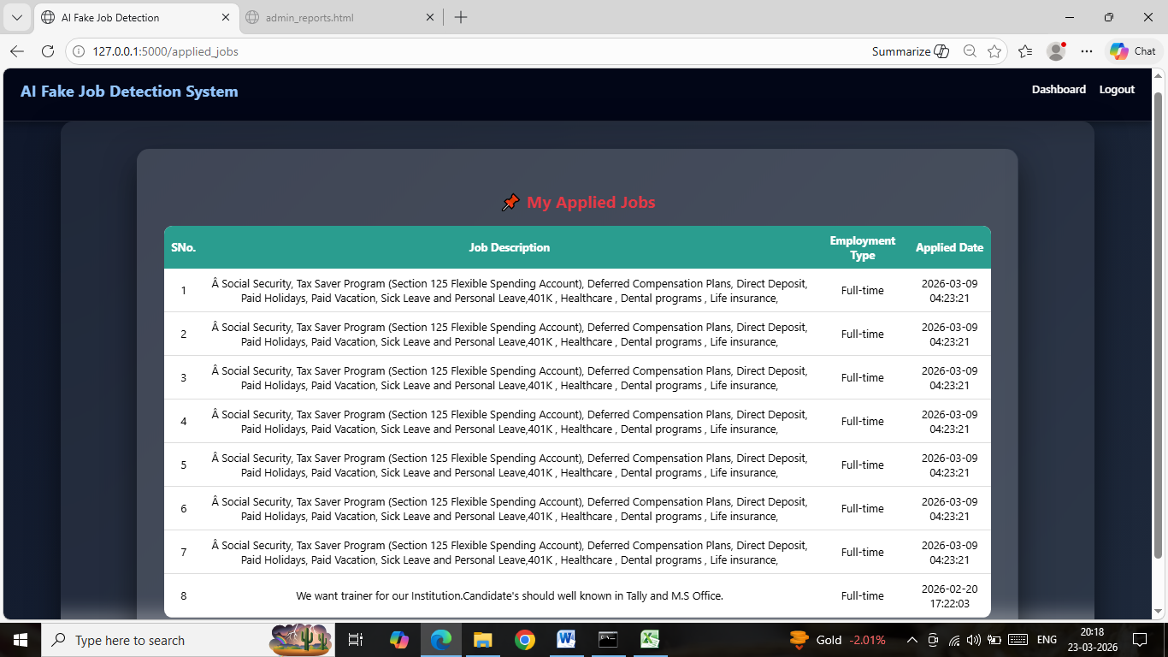
JOBS AVAILABLE
JOBS APPLIED

Slide 25
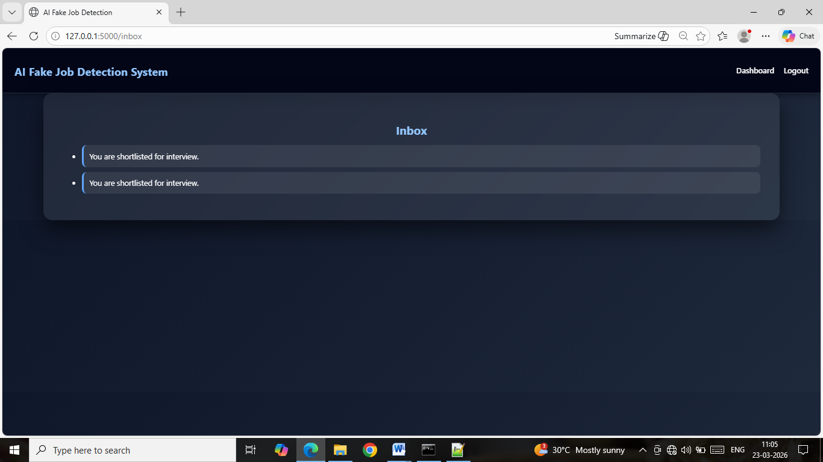
CALL LETTERS

Slide 26
CONCLUSION
The Deep Learning–Based Job Scam Detection System provides an intelligent, adaptive, and scalable solution to combat online recruitment fraud. By utilizing advanced neural networks, NLP, and behavioral analysis, the system effectively identifies fake job posts and fraudulent recruiters before they impact job seekers.
The proposed approach significantly enhances recruitment platform security, user confidence, and overall ecosystem integrity. In addition, the system’s ability to continuously learn from new data enables it to adapt to evolving scam strategies, making it a robust and future-ready solution.

Slide 27
Its scalable architecture ensures that it can be effectively deployed across various job portals, social media platforms, and recruitment ecosystems without compromising performance. By integrating automation with intelligent analysis, the system reduces manual effort while increasing detection speed and accuracy.

